Slide 1

New Web Framework
Introduction
Moses.Zhu
tech
2017/06/14

Slide 2
Agenda
简介
Portal功能介绍
使用

Slide 3
简介

Slide 4
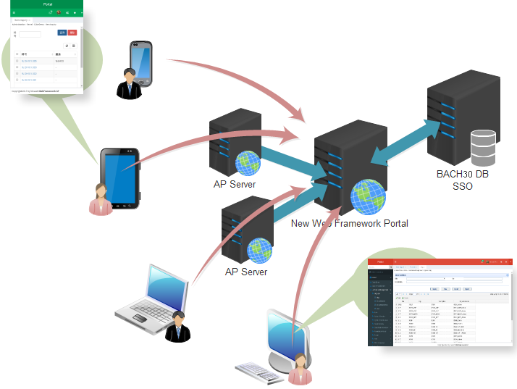
简介
基于BACH30权限模型的
新一代前端响应式框架

Slide 5
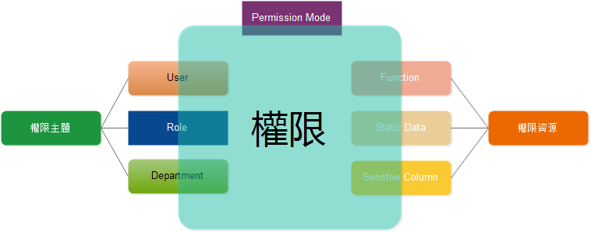
BACH30权限控制

Slide 6
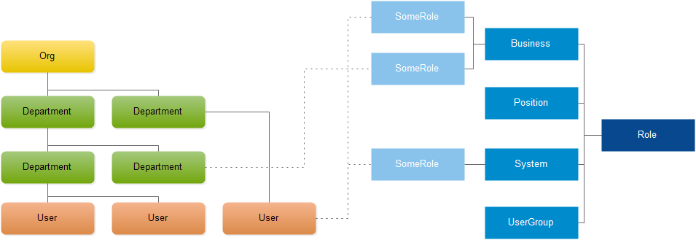
权限模型 – Org User / Role

Slide 7
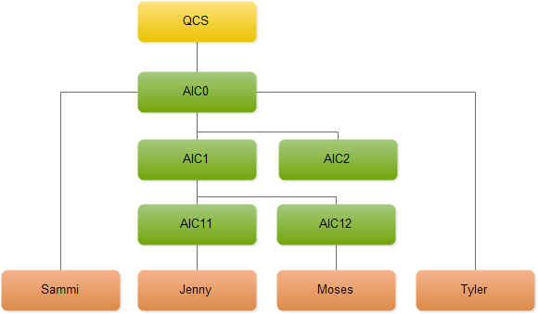
权限模型 – Org User / Role

Slide 8
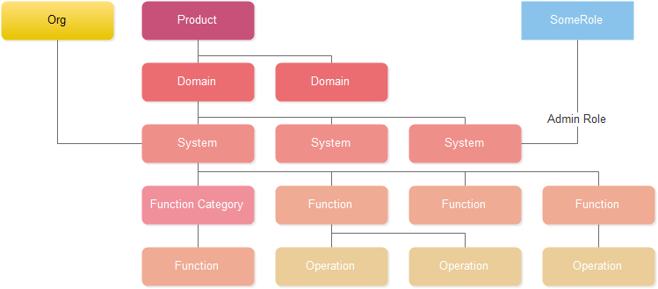
权限模型 – System Function

Slide 9
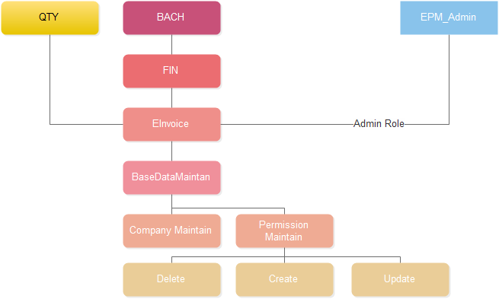
权限模型 – System Function

Slide 10
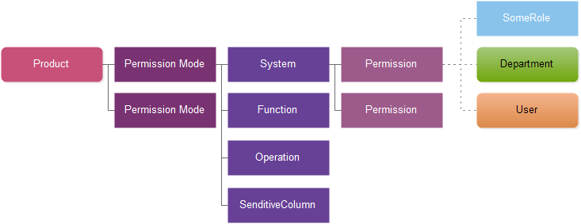
权限模型 – Permission

Slide 11
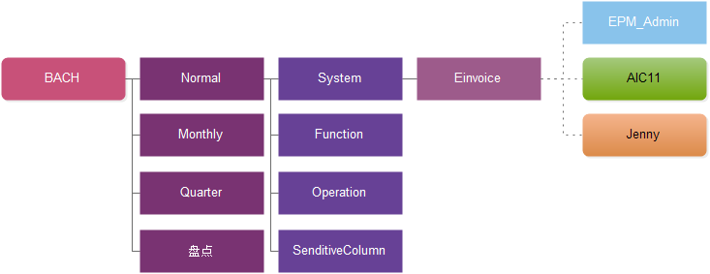
权限模型 – Permission

Slide 12
特性
多设备兼容
浏览器兼容
…
开发/测试/生产环境区分
单系统/多系统切换
…
即时语言切换
个性化定制
…

Slide 13
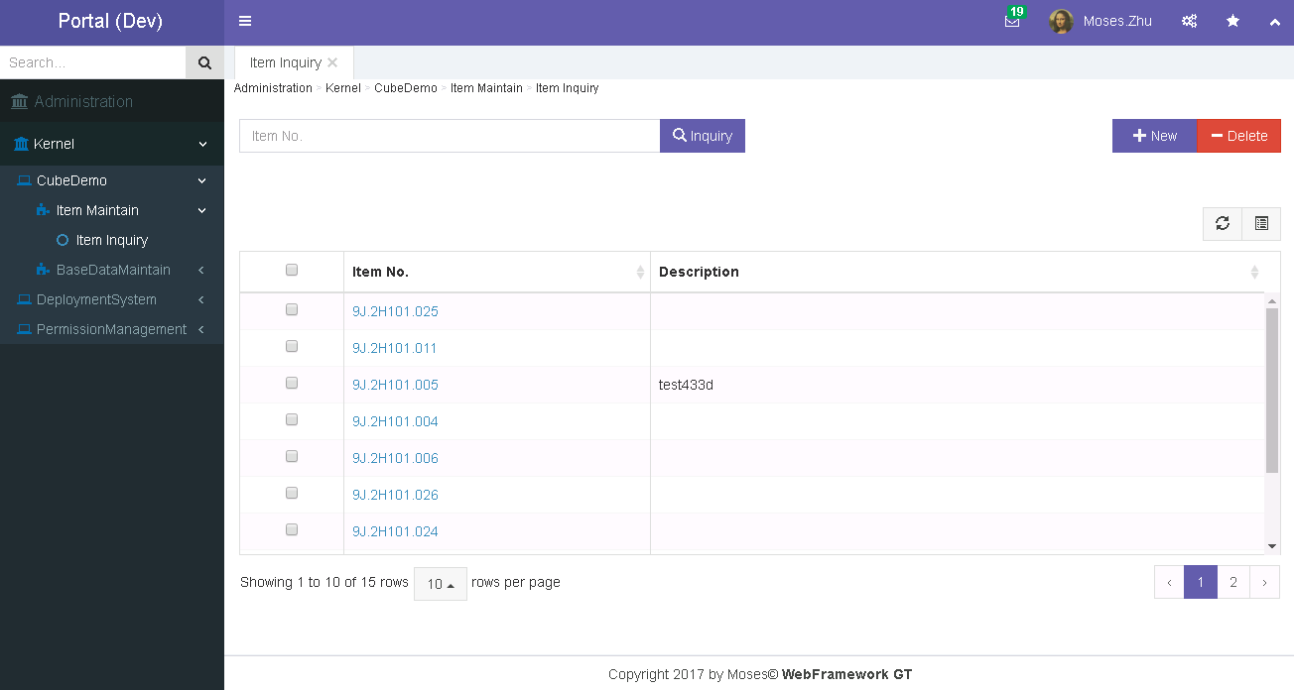
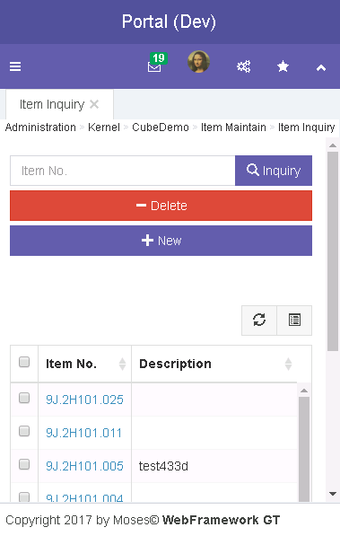
特性 - 多设备兼容（响应式UI）

Slide 14
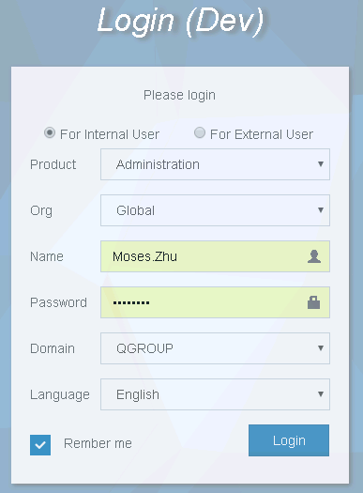
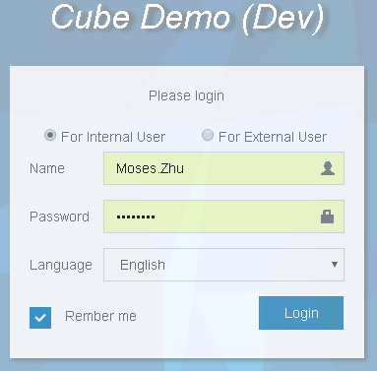
特性 – 单/多系统切换

Slide 15
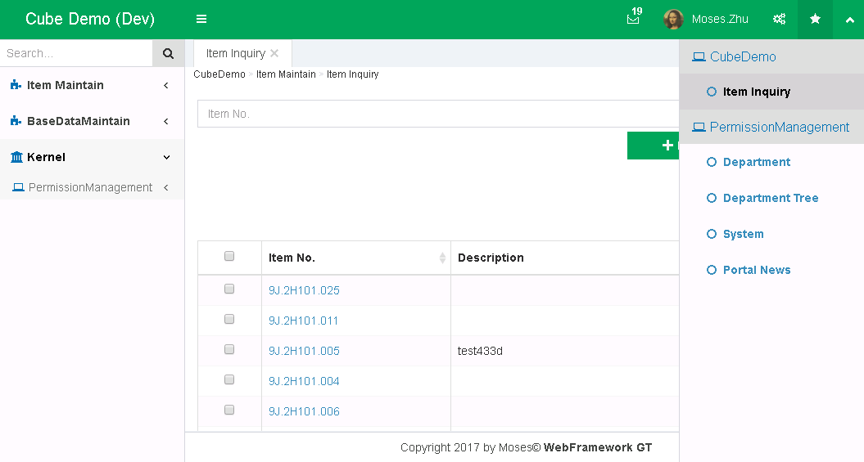
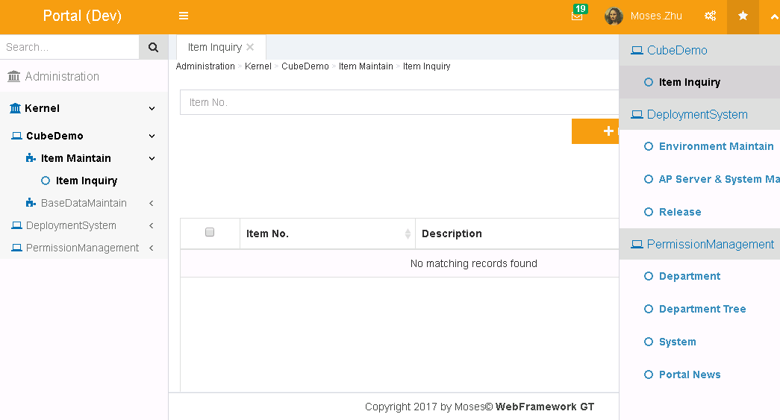
特性 – 单/多系统切换

Slide 16
Portal功能介绍

Slide 17
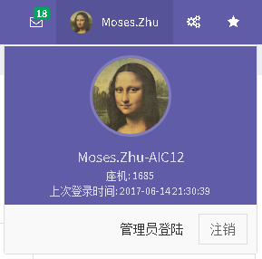
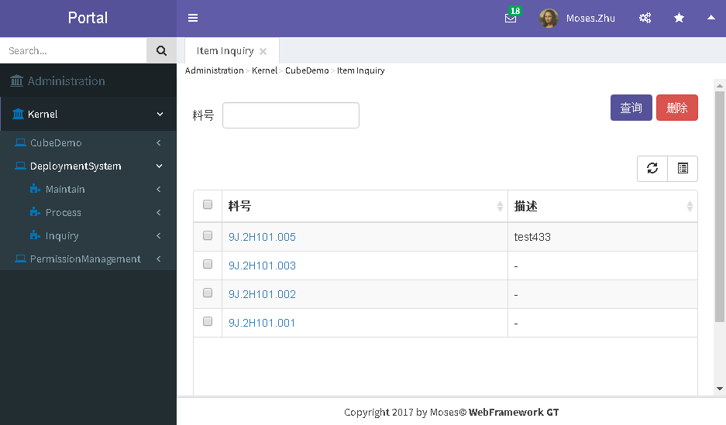
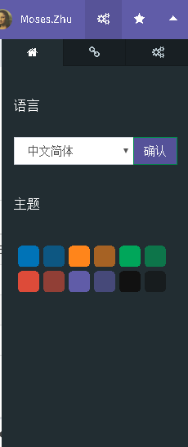
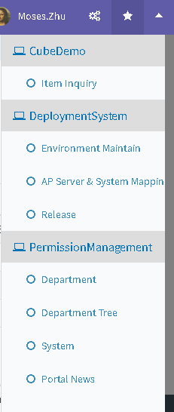
Portal区域
Header Title
Header Toolbar
Breadcrumb
User Info Panel
Menu Sidebar
Option Sidebar
Bookmark Sidebar
Footer

Slide 18
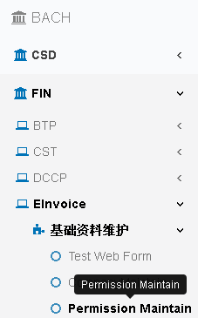
Menu
Product
Domain
System
Function Category
Tooltip
Function
Function

Slide 19
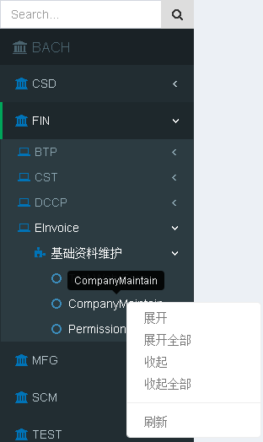
Menu
Search Menu: Click Search Button or key Enter
Right Click: Show Menu Context menu

Slide 20
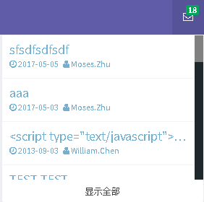
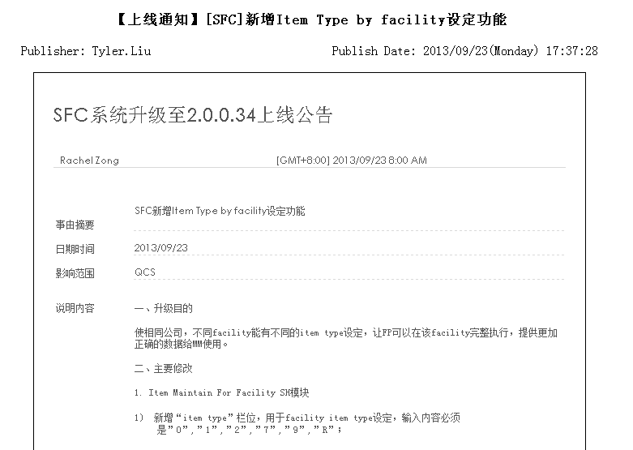
Message Panel
Badge
Subject
Click to open a new window showed message detail
Publish User & Date
Click to toggle showing All message or New message

Slide 21
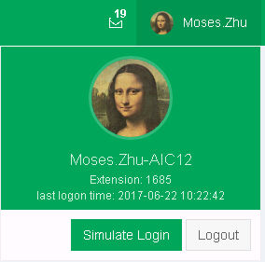
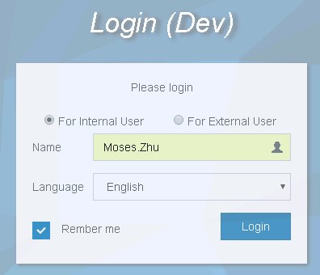
User Info Panel
Avatar
User Name / Department / Ext
Admin login button will be show if authorized
Click to logout

Slide 22
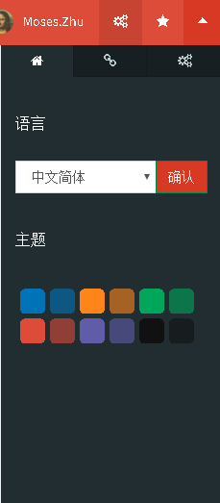
Skin & Language Setting Panel
Toggle Option sidebar
Skin & Language tab
Change language, all forms will be change
Change skin, all forms will be change

Slide 23
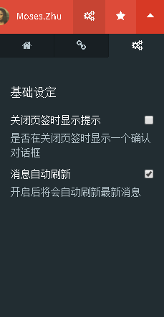
General Setting Panel
Toggle Option sidebar
General Setting tab
All setting change will effect immediately

Slide 24
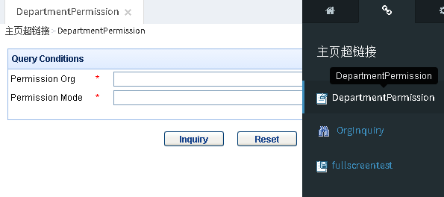
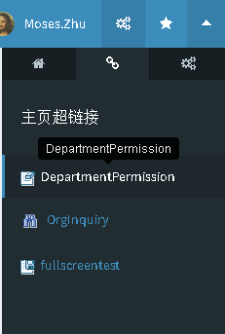
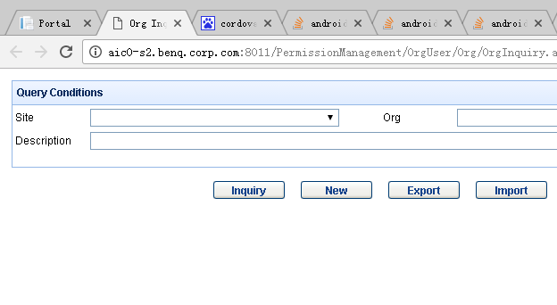
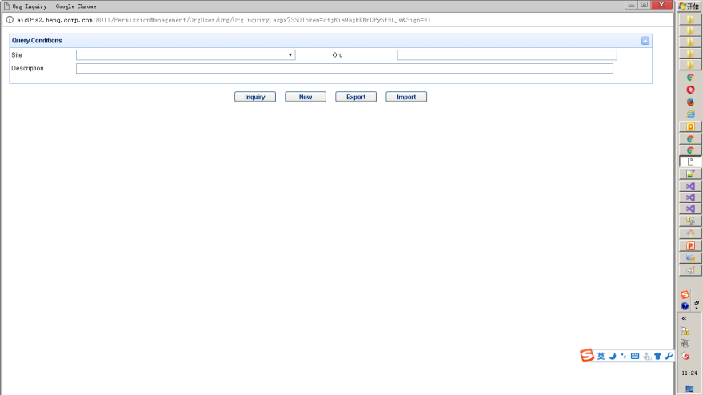
Portal Link Panel
Tab
Tooltip
Window
Full Screen

Slide 25
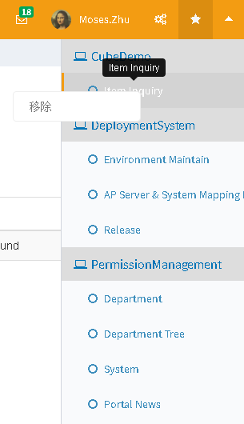
Bookmark Panel
Toggle Bookmark sidebar
Tooltip
Right Click: Show Menu Context menu, remove bookmark
System the bookmark belong to
Bookmark

Slide 26
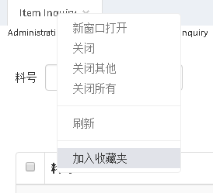
Bookmark Panel
To add a function to Bookmark, Right click this function tab

Slide 27
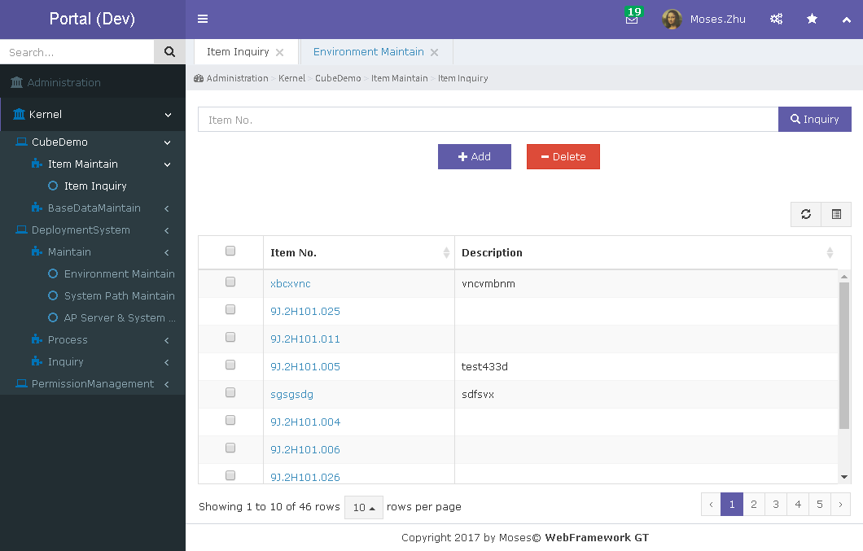

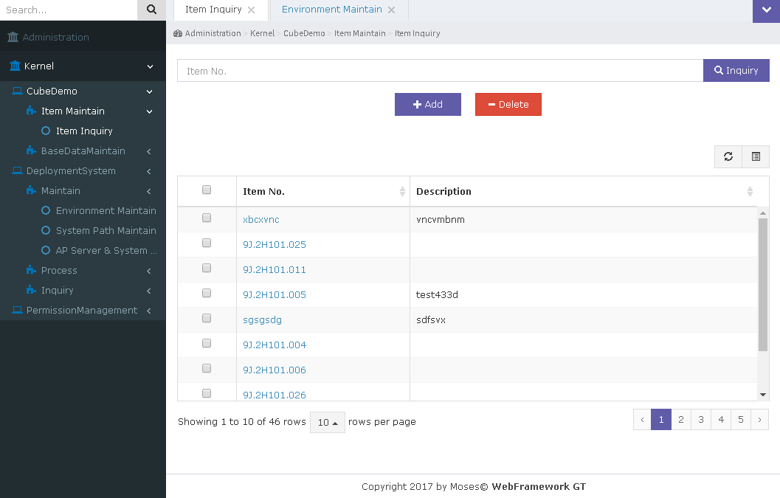

Header Visible Toggle
Click to hide Header
Click to show Header

Slide 28
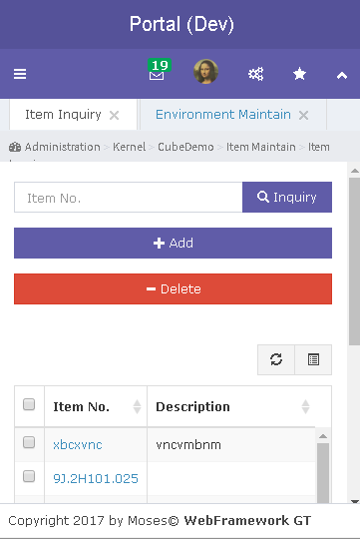
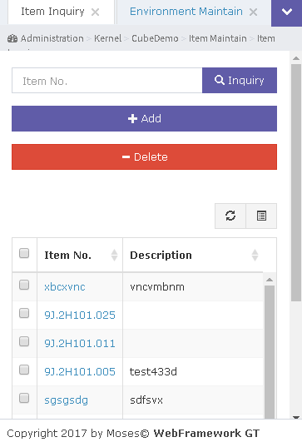
Header Visible Toggle
Click to hide Header
Click to show Header

Slide 29
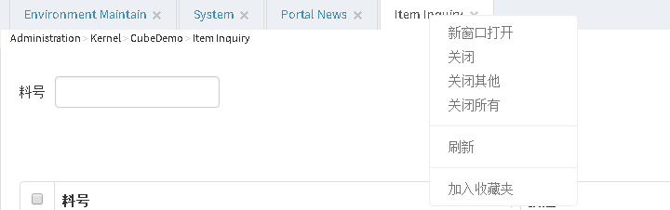
Main Content
Close Button
Right Click: Show context menu

Slide 30
使用

Slide 31
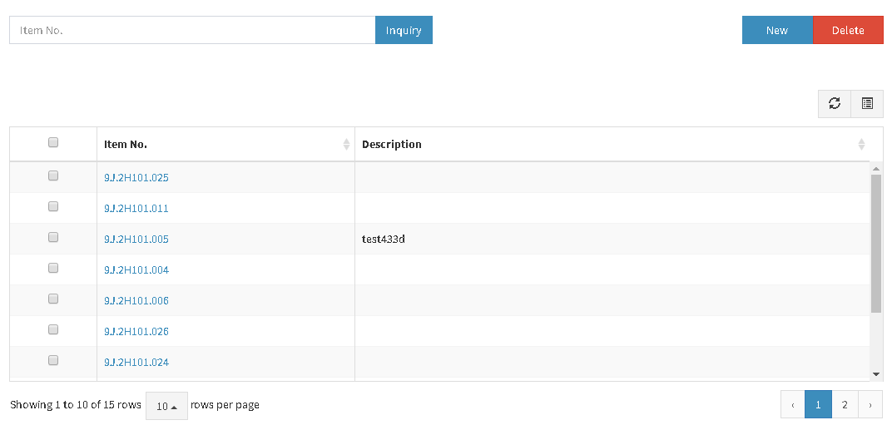
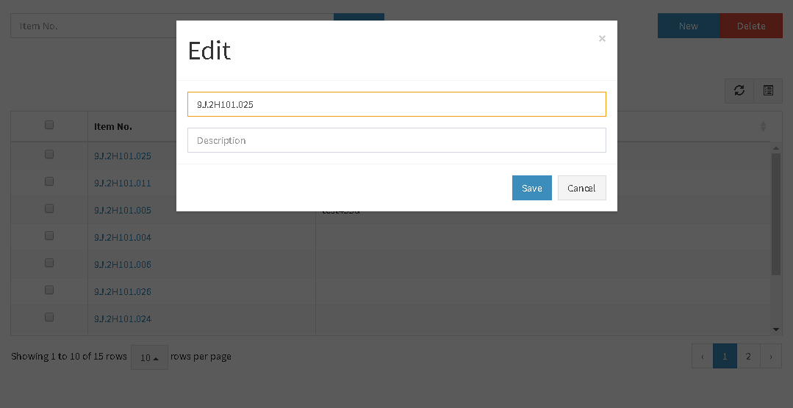
页面布局规范
Operation Area
Title
Toolbar Button
Content
Toolbar
Data Area

Slide 32
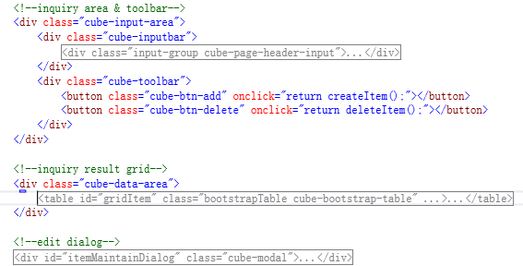
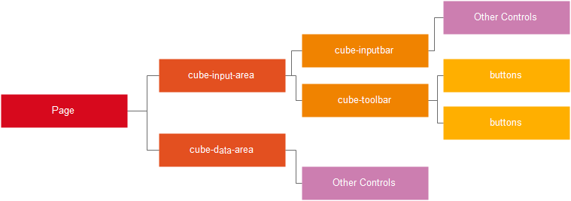
页面

Slide 33
定制控件
加上一个class属性，即无需考虑样式、多语言、自适应的问题

Slide 34
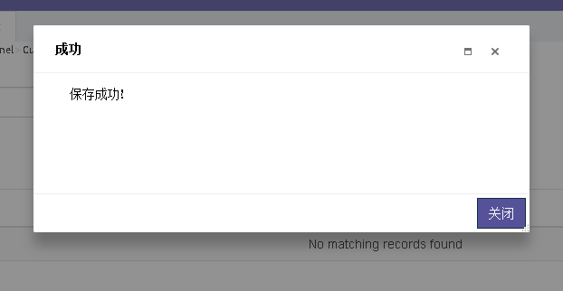
对话框
Title
Drag able
Content
Resizable
Mask

Slide 35
呼叫Service
Data
Function Name | Web Service URL
Call back, is URL …

Slide 36
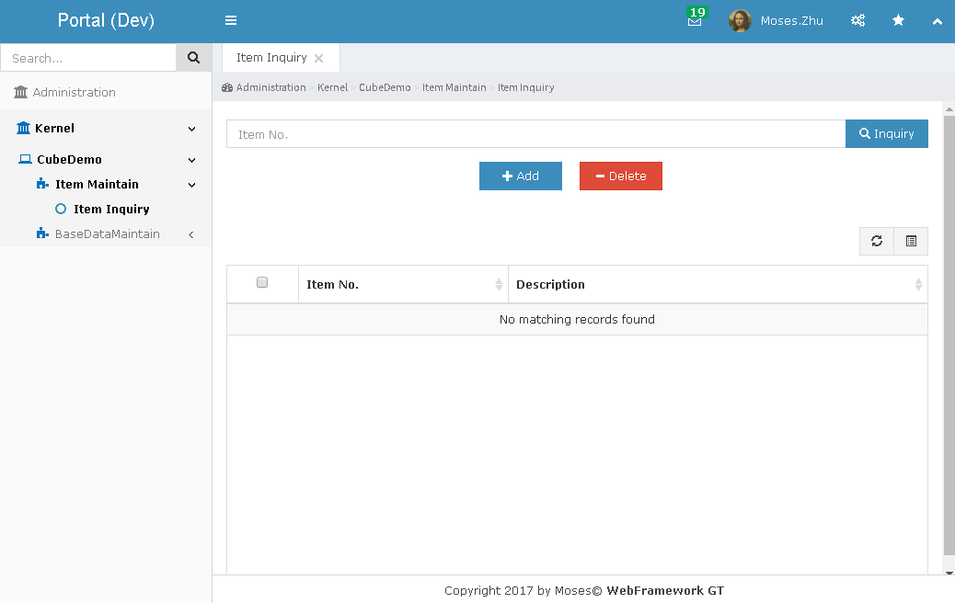
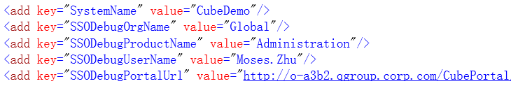
Debug

Slide 37


